Slide 1
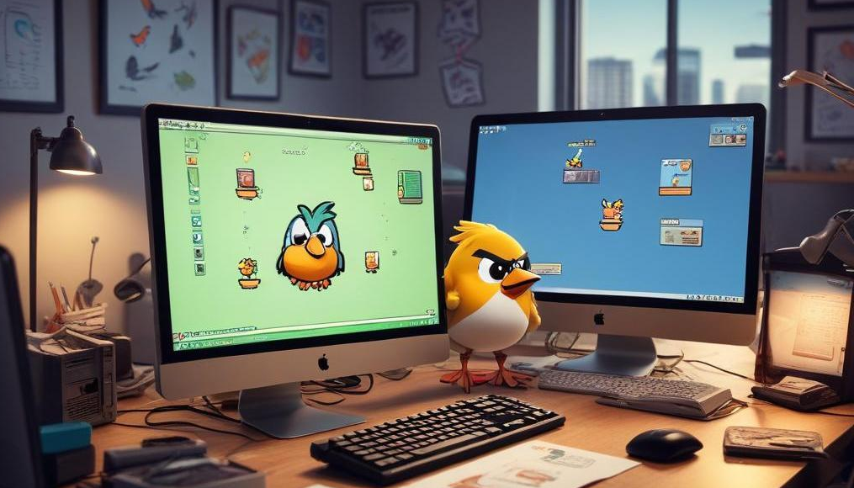
Flappy Bird C++ Project
Exploring the Development Process and Key Aspects of the Game

Slide 2
Introduction
In this presentation, we will discuss the Flappy Bird game developed in C++, covering the game overview, development processes
Group Members
~Abhinav Gomra 24MIP10039
~ Toshan Arora 24BAI10247
~ Arjunkumar Udawant 24MIP10063
~ Ayush Kaushik 24bce11090
~John james 24bai10321

Slide 3
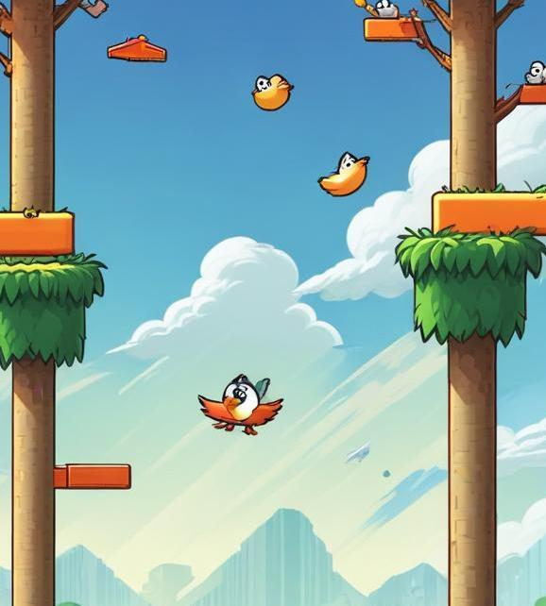
01
Game Overview

Slide 4
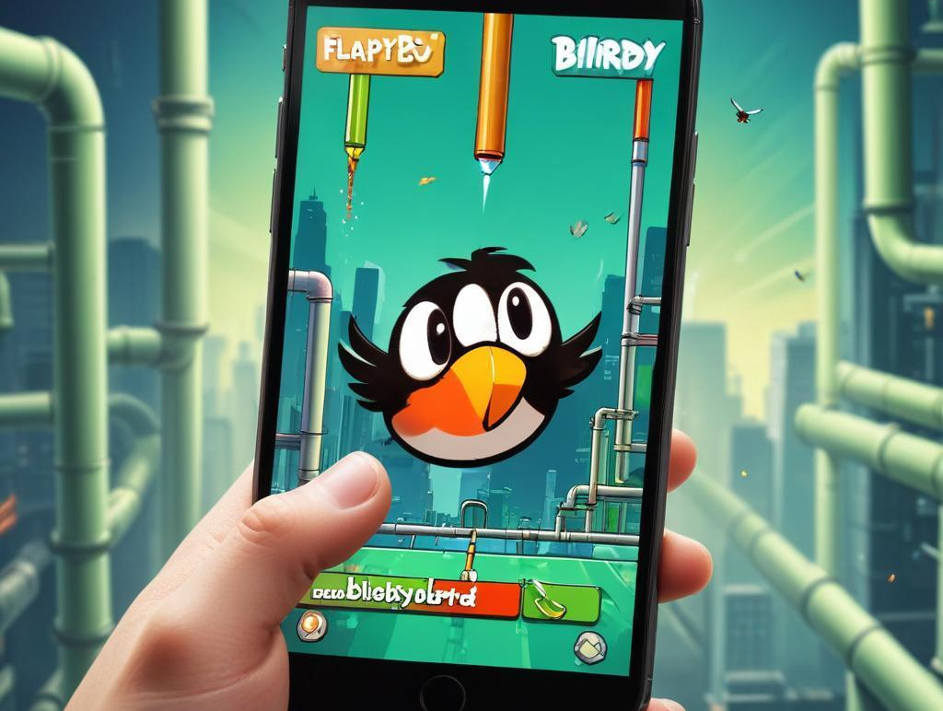
Game Concept
Flappy Bird is a simple yet addictive game where players control a bird to navigate through gaps between obstacles. The game's mechanics depend on timely taps to keep the bird aloft while avoiding pipes.

Slide 5
Conclusions
The Flappy Bird C++ project exemplifies a straightforward game concept developed through a structured process. Understanding audience requirements and efficient technical implementation are key to successful game development.
GitHub Account :-
https://github.com/abhinavgomra/C-Group_project

